Slide 1
Generating Personalized Emails with GPT-2
Group O: Yun Cao, Yue Liu, Muyang Cheng, Nan Chen

Slide 2
Introduction

Slide 3
Personal Emails Generation
This project aims to create an effective communication tool that can help establish connections on platforms like LinkedIn. We trained a model using GPT-2 to generate personalized emails based on user inputs.
Task: Text Generation
Model: postbot/distilgpt2-emailgen-V2
Dataset: LightTai/personalized-email
Libraries: Transformers, datasets, torch, scikit-learn, accelerate

Slide 4
Main Problem
How to train our model to generate personalized emails?
How to use our model?
How to evaluate our model?
How to avoid misuse of our models and ethical considerations?

Slide 5
Analysis and Findings

Slide 6
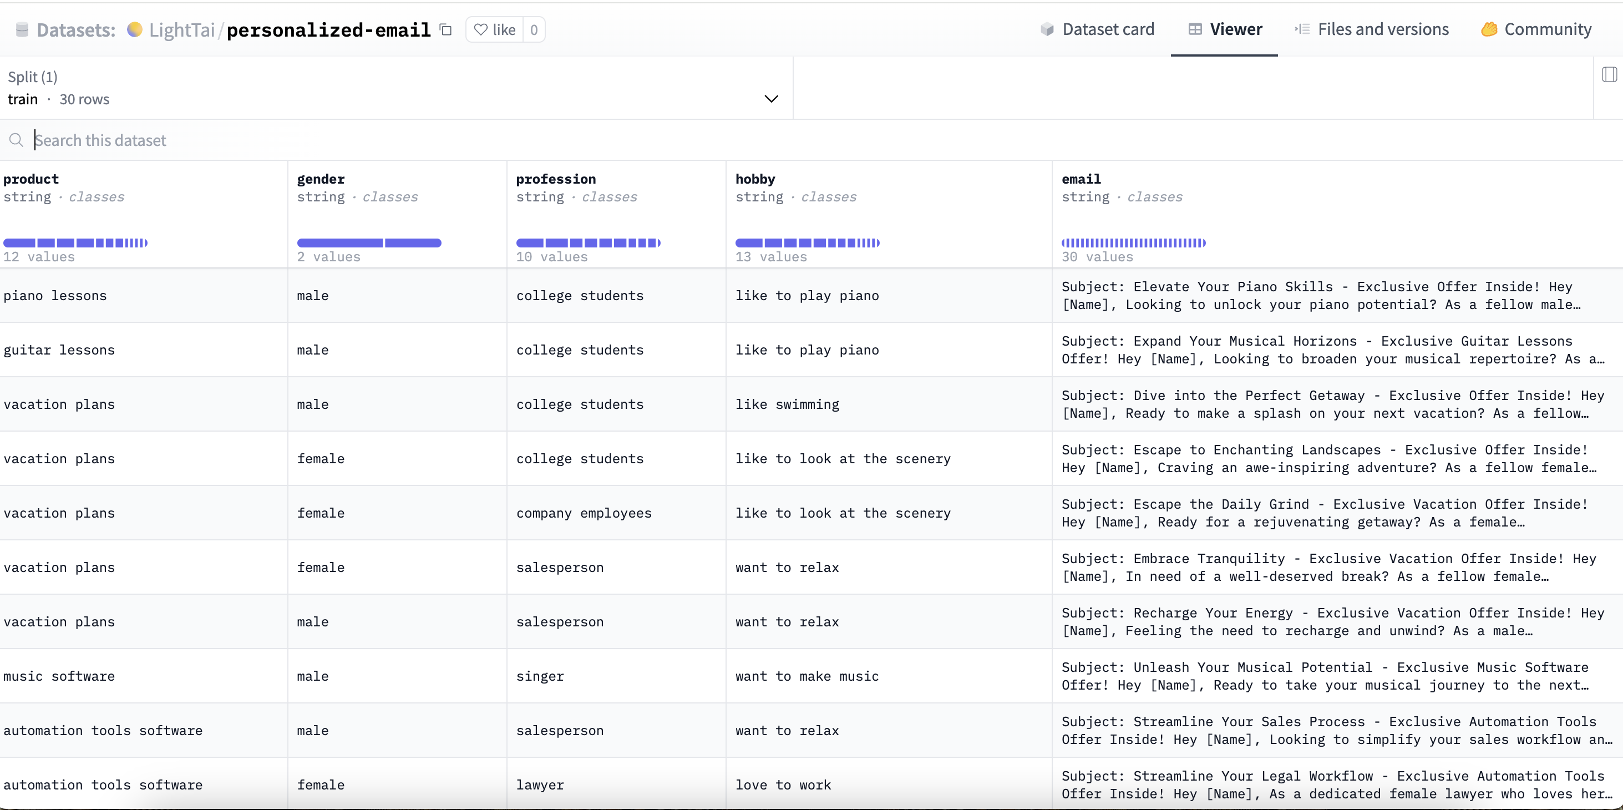
Model
Data Analysis

Slide 7
Model
NLP Methodology and Techniques Employed
Text Classification/Segmentation: To analyze the customer base and categorize it based on different attributes such as gender, profession, and hobbies. This would involve supervised learning algorithms that could classify text into pre-defined classes based on the training data provided in the dataset.
Sentiment Analysis: To understand the sentiment behind the hobbies or professions listed, which might then influence the tone and style of the email content.
Template-Based Text Generation: For generating personalized emails, a template-based approach would be used. Templates would have placeholders for names, professions, products, etc., that would be dynamically filled based on the customer data.
Feature Extraction: Before any text generation, it would be necessary to extract features from the text that are relevant to the product, gender, and hobbies, and use them to tailor the content of the emails.
Data Preprocessing: Cleaning and organizing the data to ensure the NLP models work efficiently. This would include tokenization, stemming, lemmatization, and removal of stop words.

Slide 8
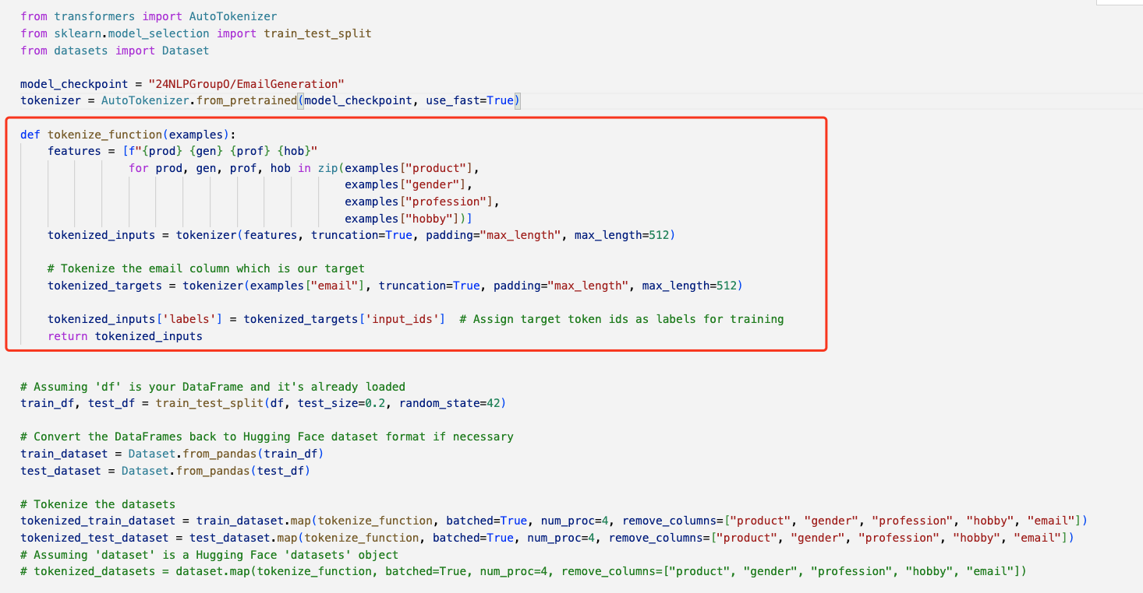
Model
Explain Dataset to Model Tokenize

Slide 9
Model
Explain Dataset to Model Tokenize
Loading Pre-trained Model Tokenizer: An AutoTokenizer is loaded with a specified pre-trained model checkpoint. The tokenizer is a crucial tool that converts text data into a format that can be processed by machine learning models.
Tokenization Function: The function tokenize_function is defined to tokenize the inputs. It takes examples from the dataset and extracts the product, gender, profession, and hobby columns. These columns are tokenized, meaning they are converted into a sequence of numbers that represent the text in a way the model can understand. There's a special focus on the email column since it is the target variable (what the model will learn to generate).
Processing the Dataset: The dataset is split into a training set and a test set with a 50/50 split. The original DataFrame is then converted into a Dataset object, which is a more efficient format for handling datasets in machine learning workflows.
Tokenizing the Dataset: The actual tokenization process happens where the training and test sets are mapped with the tokenize_function. This means that all the text data in these datasets is converted into tokens.

Slide 10
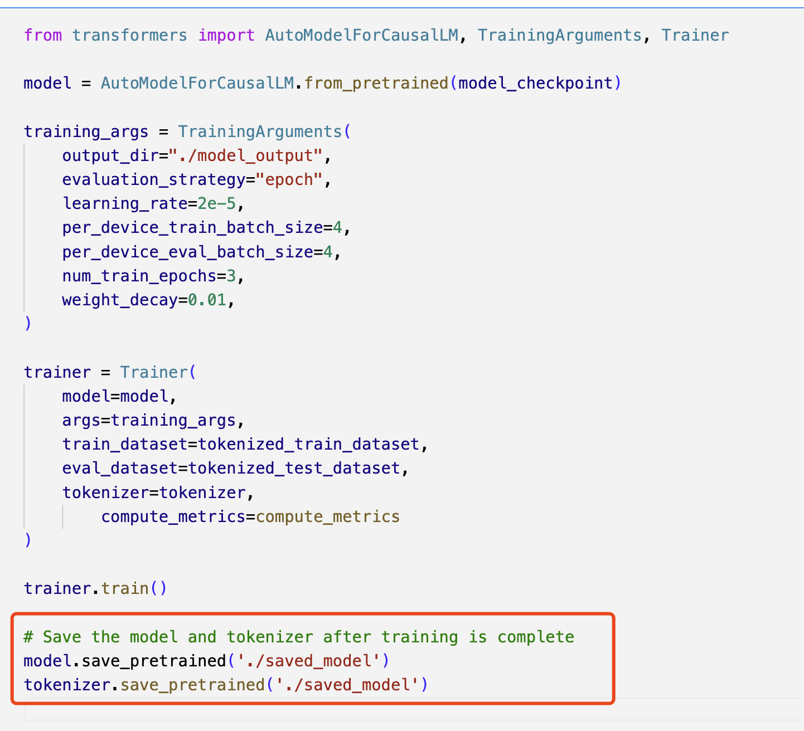
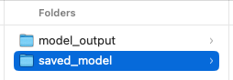
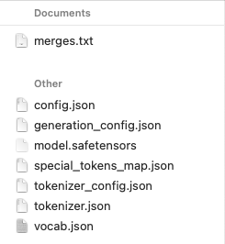
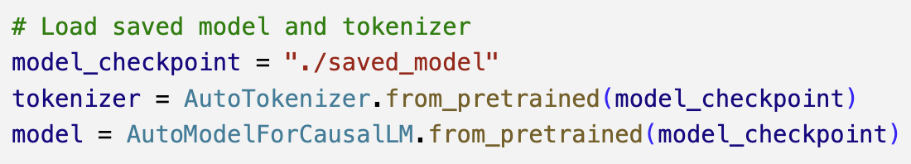
Model
Save and Load Model

Slide 11
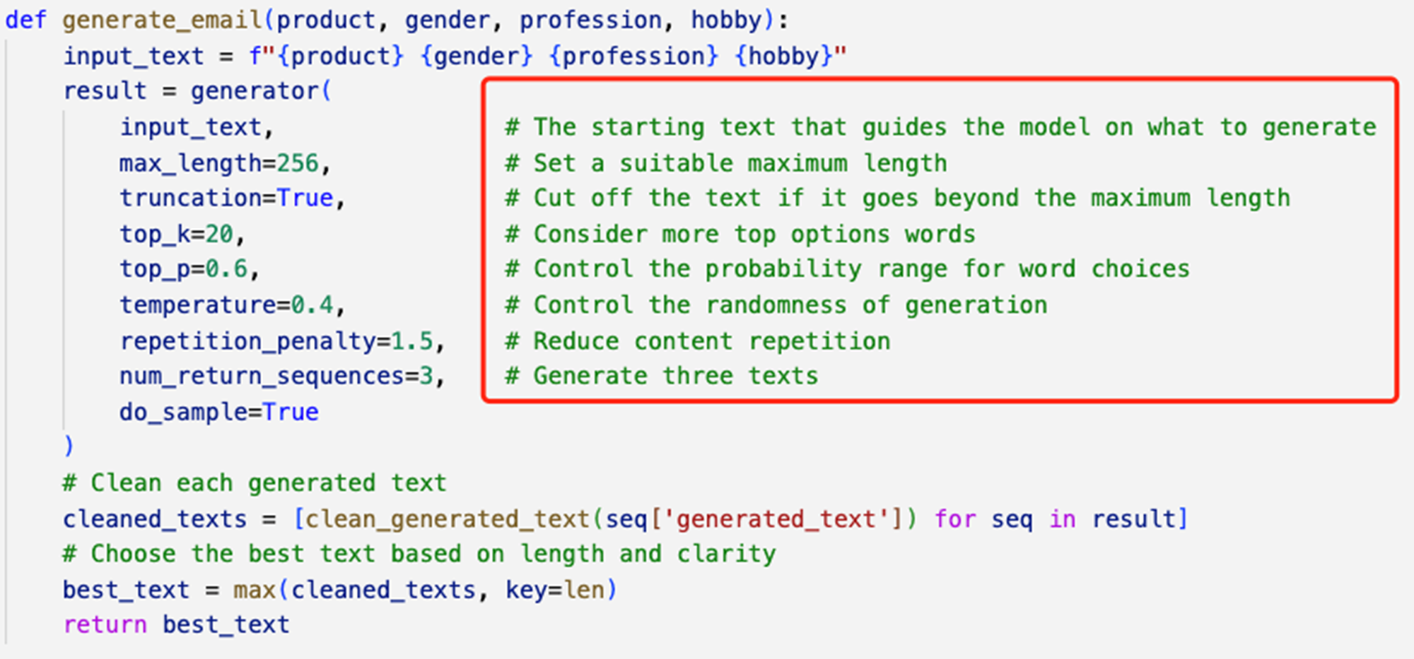
Model
Parameters

Slide 12
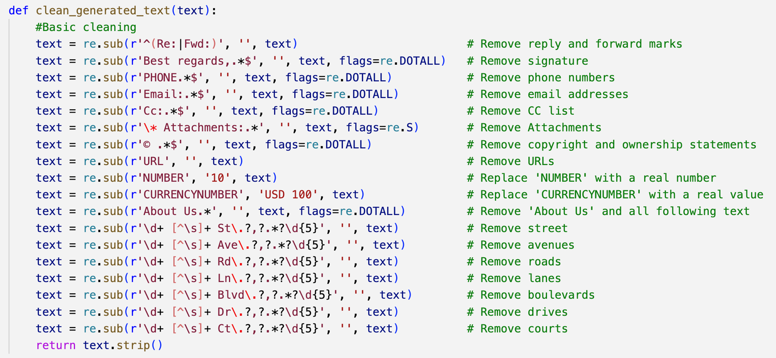
Model
Basic Clean

Slide 13
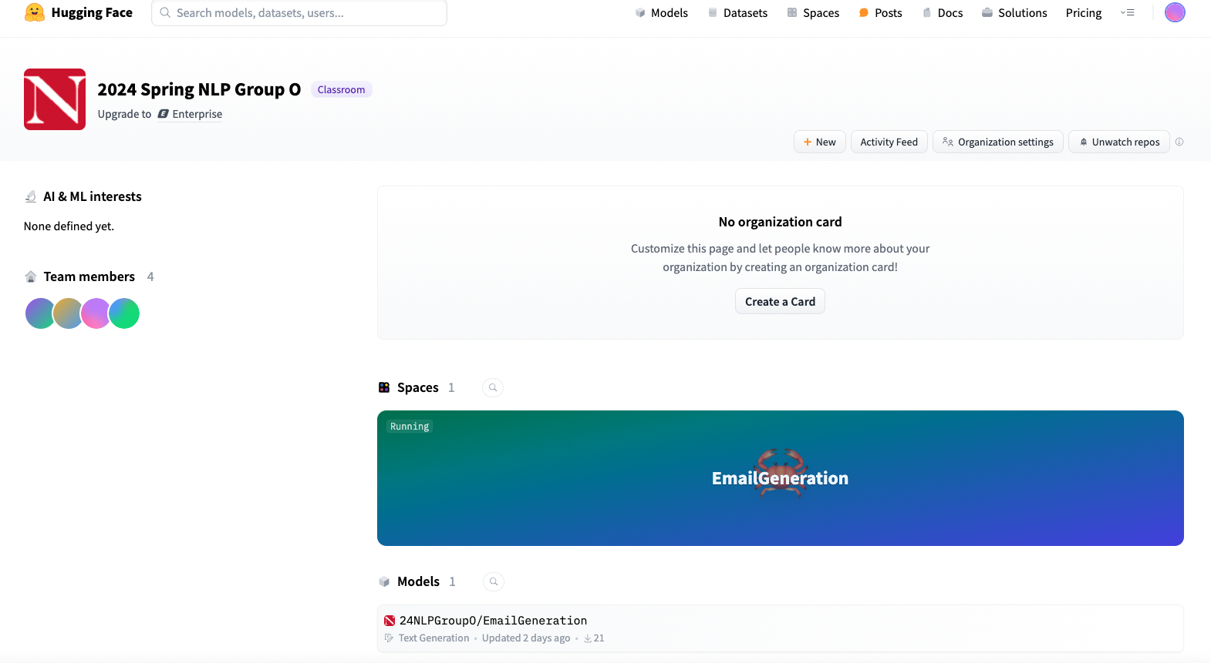
Usage

Slide 14
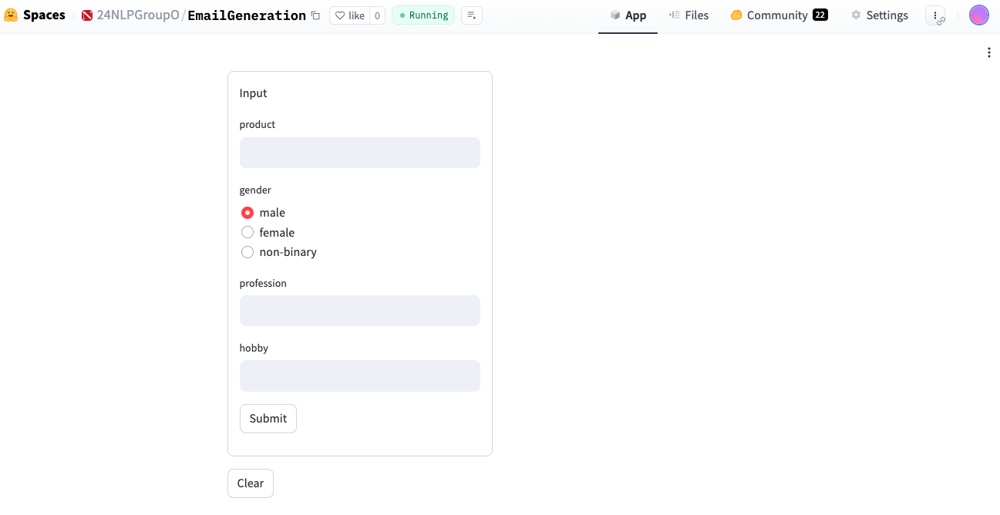
Usage
Start the app

Slide 15
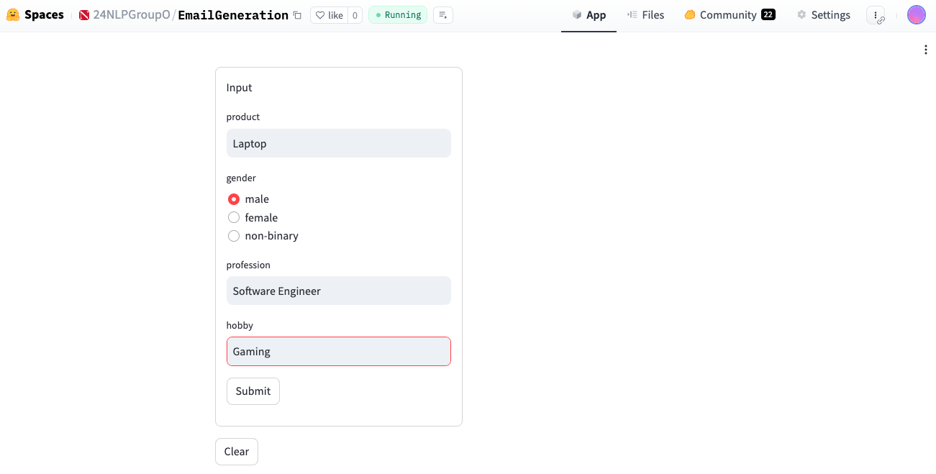
Usage
User input

Slide 16
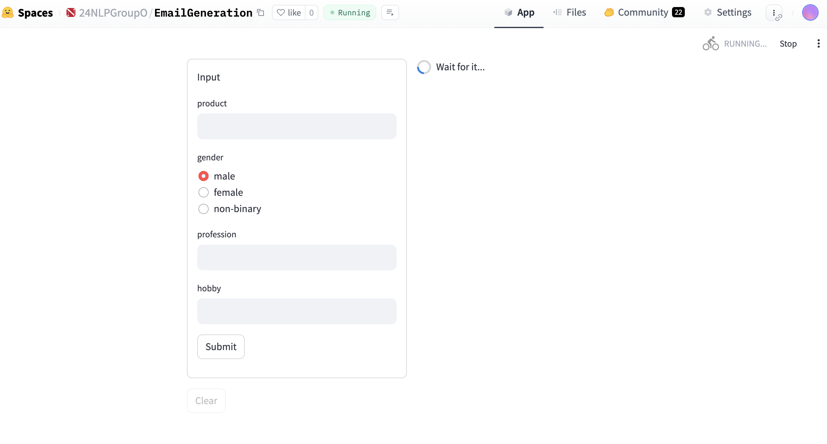
Usage
Wait for minutes

Slide 17
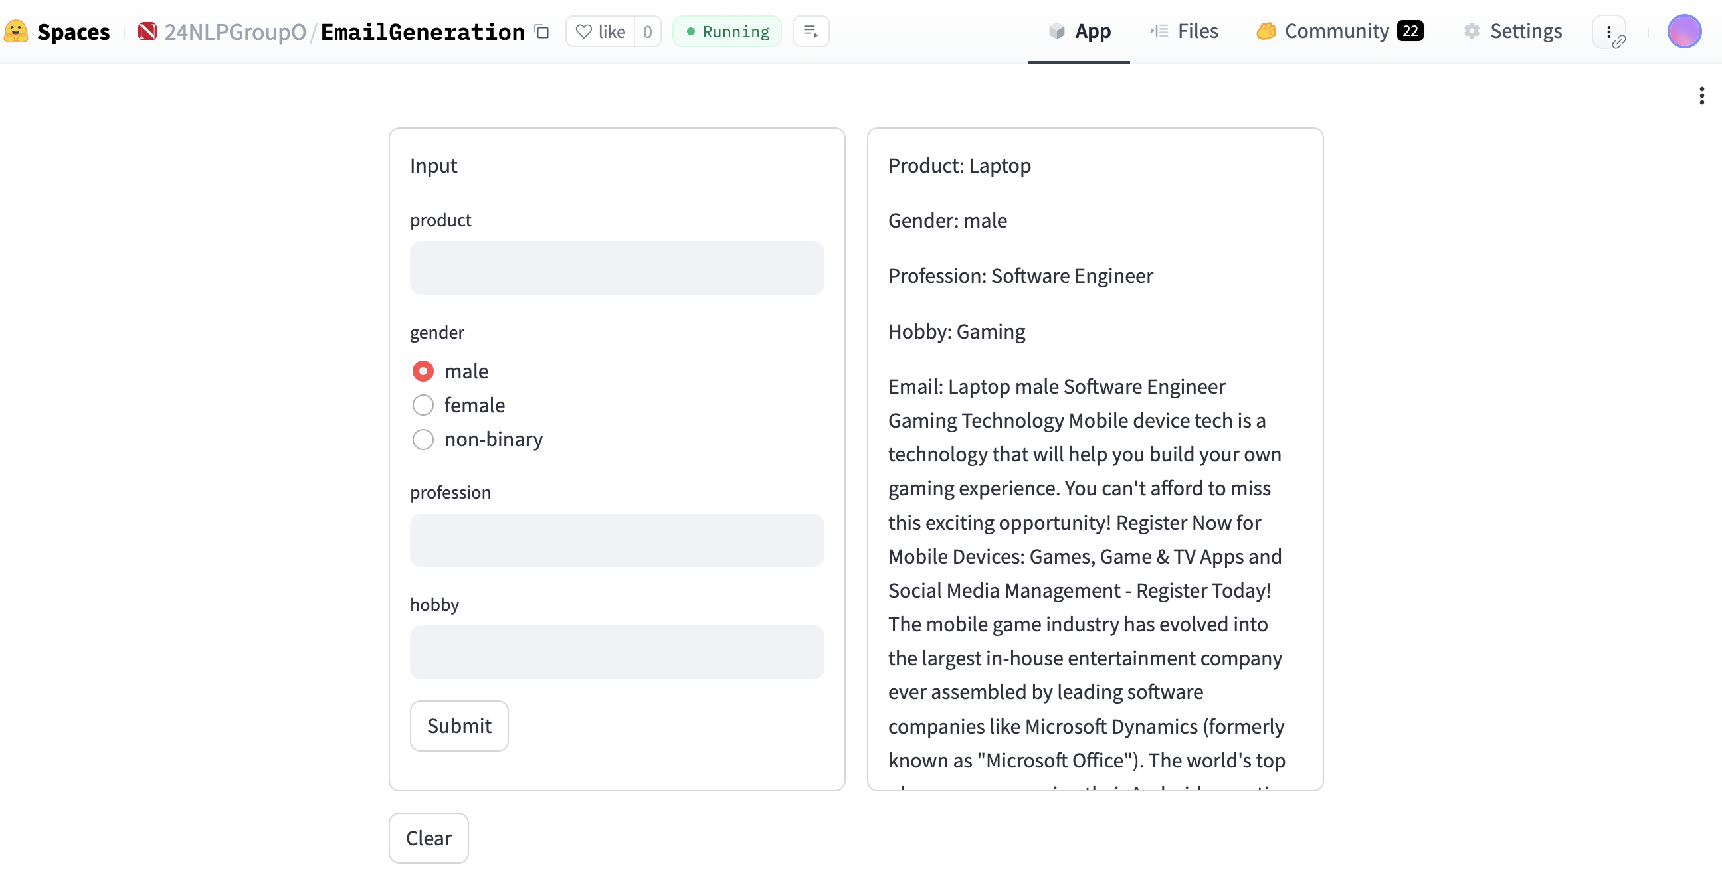
Usage
Output

Slide 18
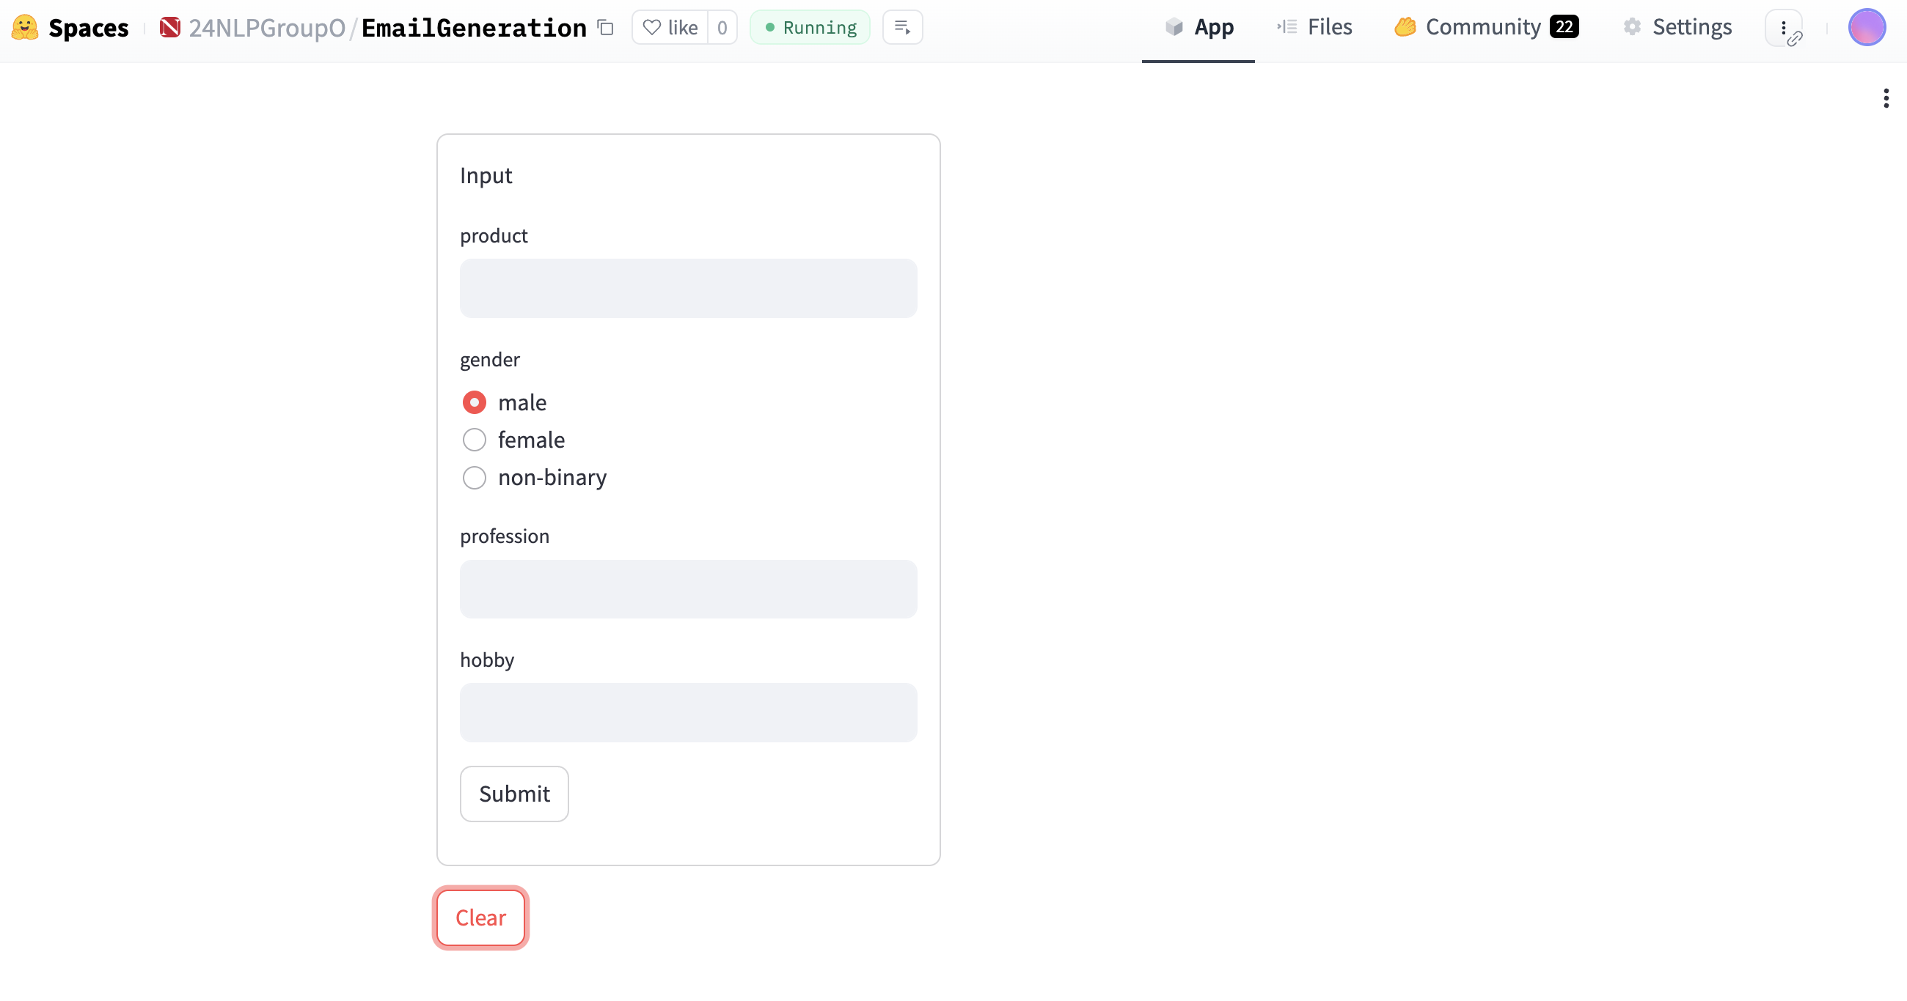
Usage
Clear

Slide 19
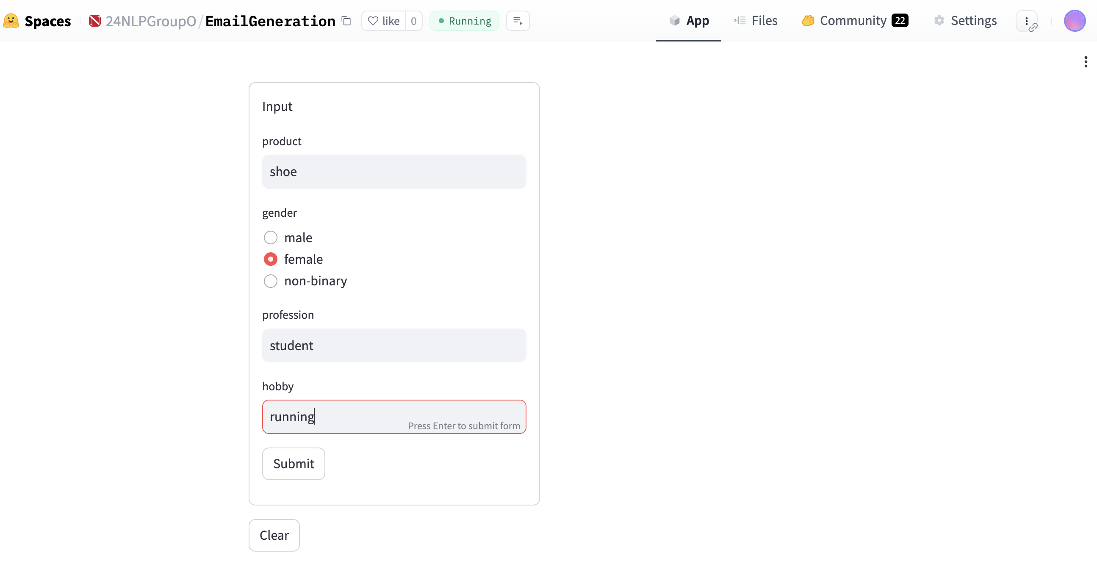
Usage
Retry

Slide 20
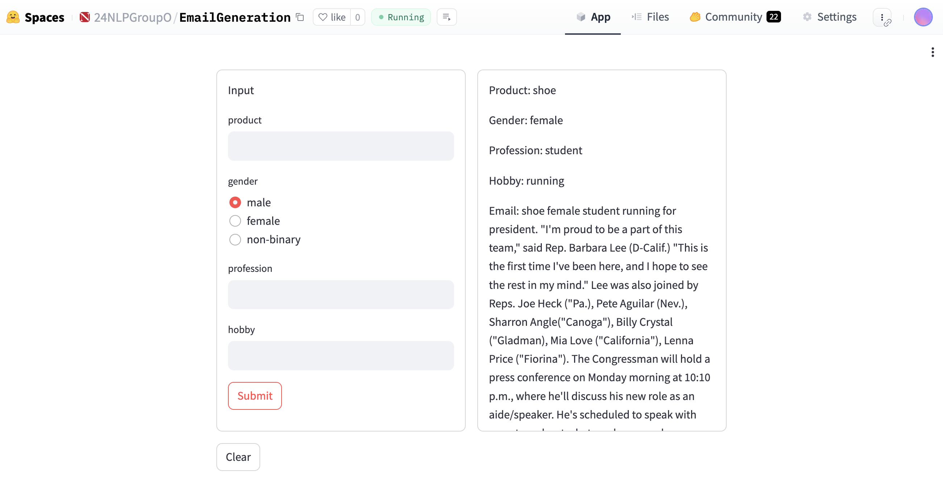
Usage

Slide 21
Evaluation
BERT Bidirectional Encoder Representations from Transformers
BLEU Bilingual Evaluation Understudy
ROUGE Recall-Oriented Understudy for Gisting Evaluation
 | BERT | BLEU | ROUGE
Target | 1.0 | 1.0 | 1.0
GPT3.5 | 0.843668 | 0.052389 | 0.316623
Translated Twice | 0.96876 | 0.564568 | 0.819048
Title | 0.954038 | 0.000041 | 0.140351
X | 0.774057 | 0.0 | 0.0

Slide 22
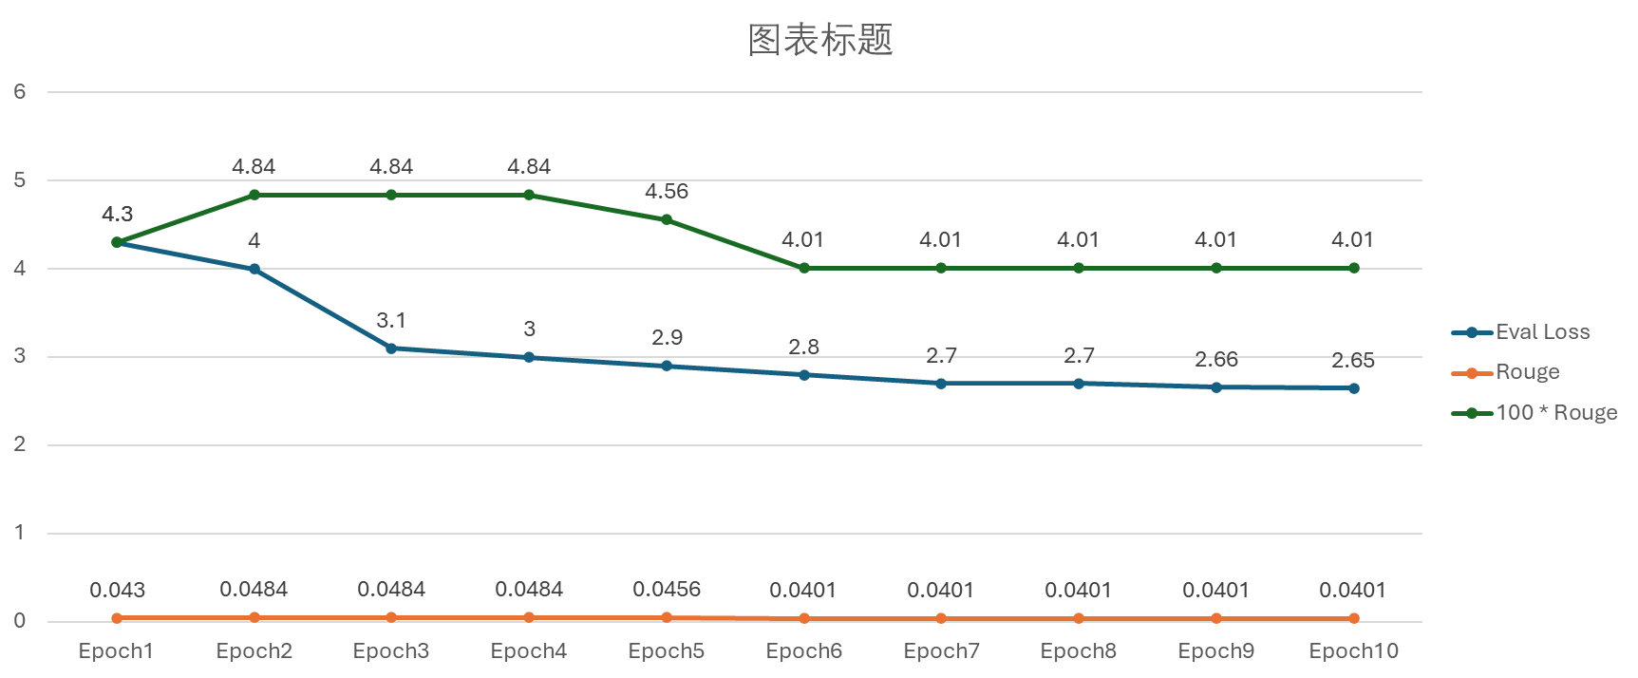
Eval Loss and Rouge Metrics
Evaluation
Final perplexity: 14.17

Slide 23
Limitations and Lessons Learned

Slide 24
Limitation
Model results: The output email is not the email we want to generate. Also, we can’t avoid generating spam or phishing emails. Based on the analysis, it won't improve with continued training. We guess there are two reasons for this:
(1) Limitations of the model itself (2) Limitations of the dataset
Processing Time: The model takes over three minutes to run in the application. This could potentially lead to a less-than-optimal user experience, especially if users are expecting quick results.
Data Formatting: Ensuring the output is well-formatted and easy to understand is crucial for the end-user experience. The generated email does not have a perfect format.

Slide 25
Lesson
The use of hugging face: Understood the process of uploading models and building spaces from scratch on hugging face. Also learned how to work together on hugging face.
The effect of model parameters: Figure out how to add or modify parameters to change the model outputs.
Evaluation model: Understood the effect of different evaluations, and thought about how to choose the right evaluation.
Interactive User Interface: We use Streamlit to create an interactive user interface for the model. It provides a user-friendly way to input data and view the results.
Ethical consideration: We consider the ethical nature of model-generated content. Learned about methods to avoid generating spam and phishing.

Slide 26
Thanks!

